Slide 1
CIS 508 Machine Learning in Business
Assignment – 3
Ishika Gupta - 1229311176

Slide 2
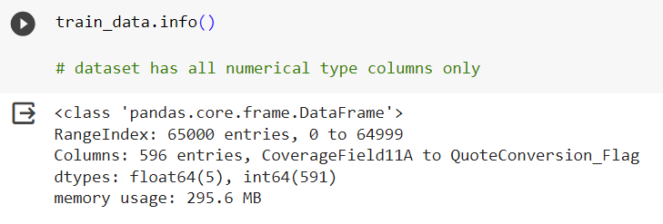
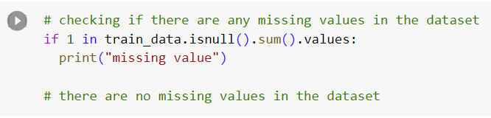
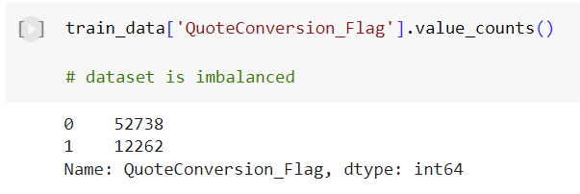
Problem Statement and Dataset
We have to predict the probability of a customer buying a quoted insurance plan
Binary Classification
Training data: 65000 rows, 596 columns
Testing data: 17836 rows, 596 columns
Training dataset: Numerical dataset, no missing values, imbalanced dataset

Slide 3
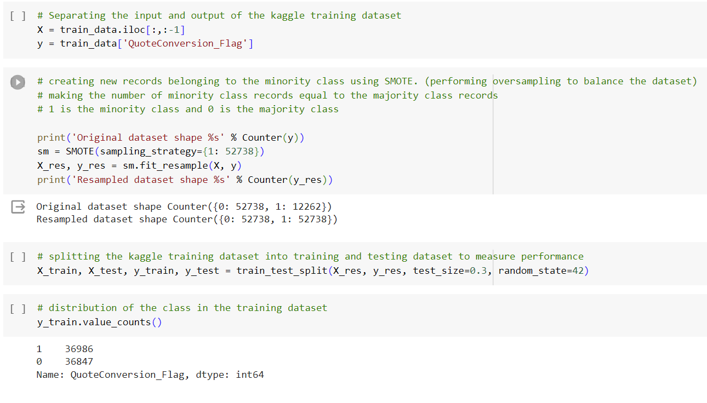
Data Preprocessing
Deleting a column from the testing dataset since it is not present in the training dataset
Performing SMOTE oversampling to balance the dataset – Making the number of records belonging to the minority class the same as the number of records belonging to the majority class

Slide 4
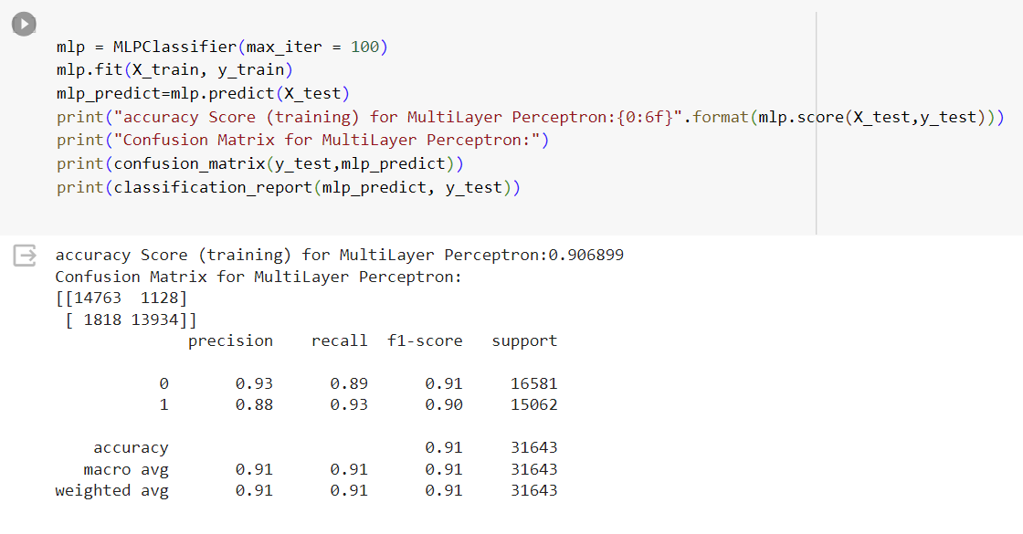
Building and training models
Individual Models – Multi Layer Perceptron

Slide 5
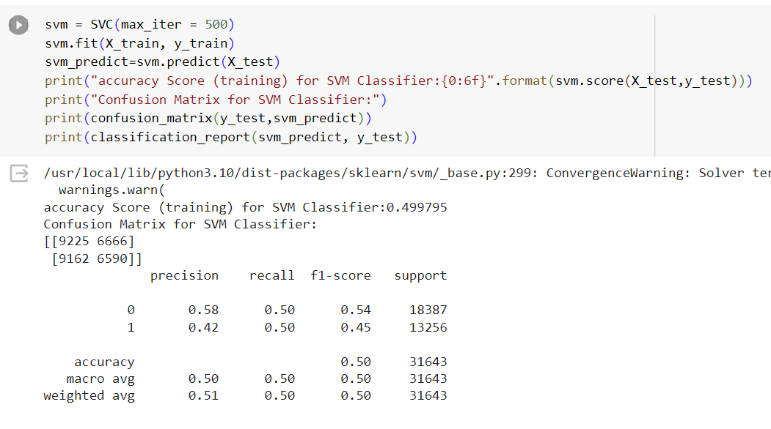
Building and training models
Individual Models – Support Vector Classifier

Slide 6
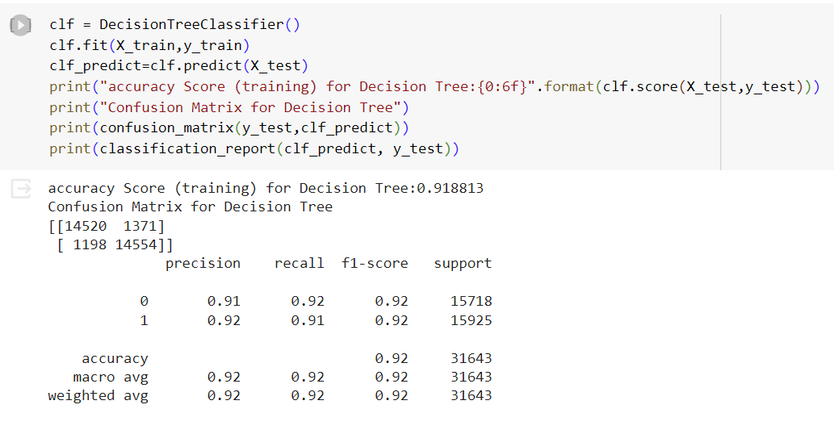
Building and training models
Individual Models – Decision Tree Classifier

Slide 7
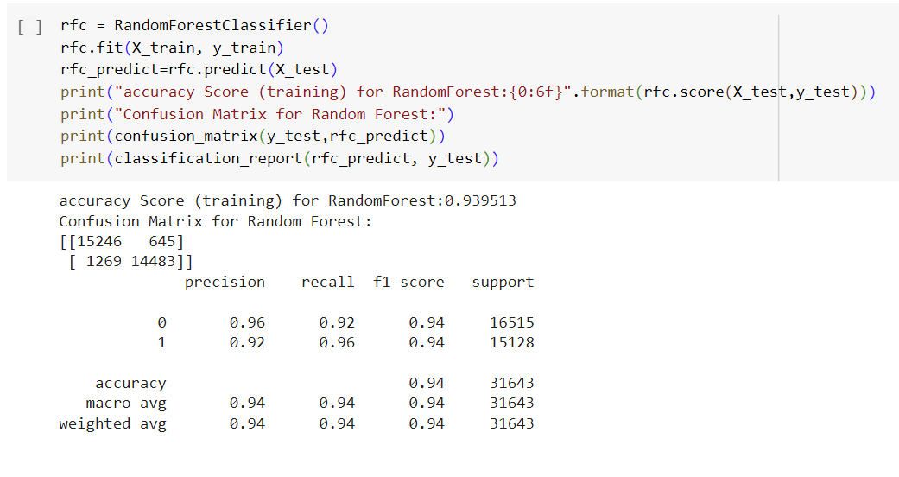
Building and training models
Individual Models – Random Forest Classifier

Slide 8
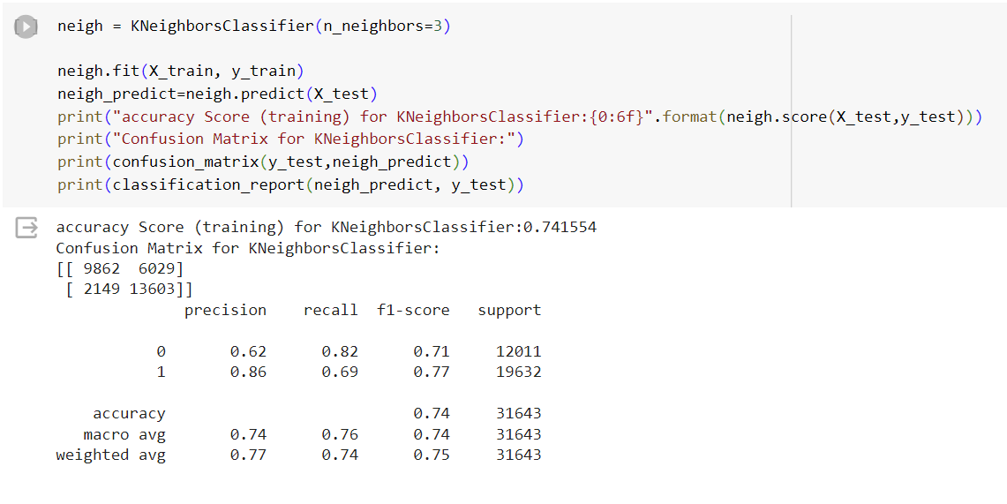
Building and training models
Individual Models – K neighbors Classifier

Slide 9
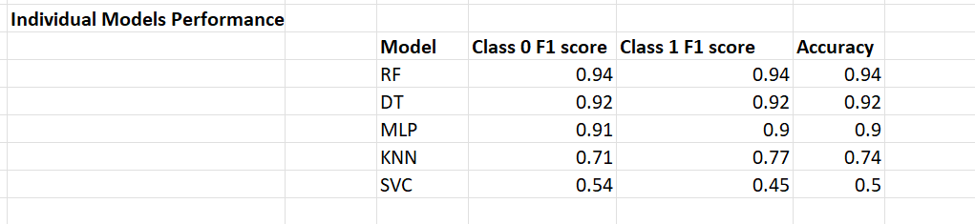
Model Performance Comparison
Random Forests perform the best
Support Vector machines perform the worst

Slide 10
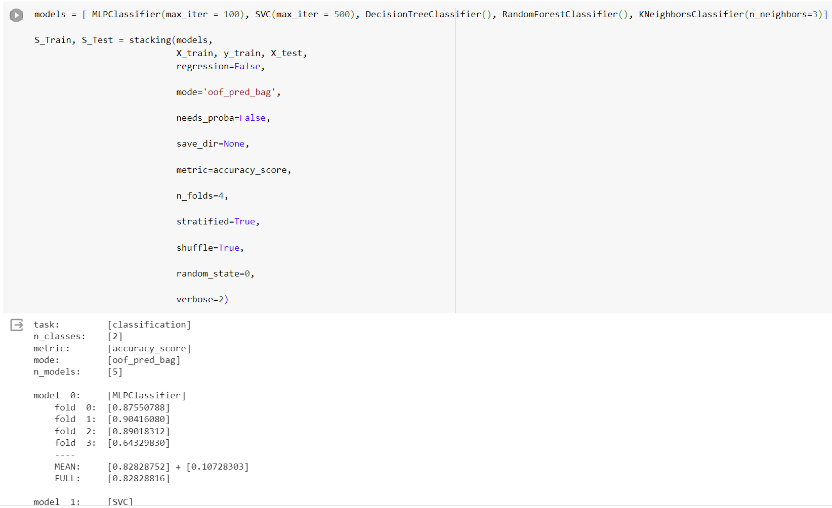
Performing Stacking

Slide 11
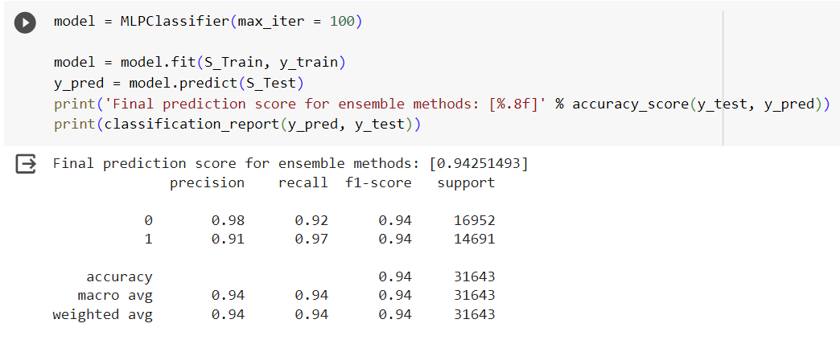
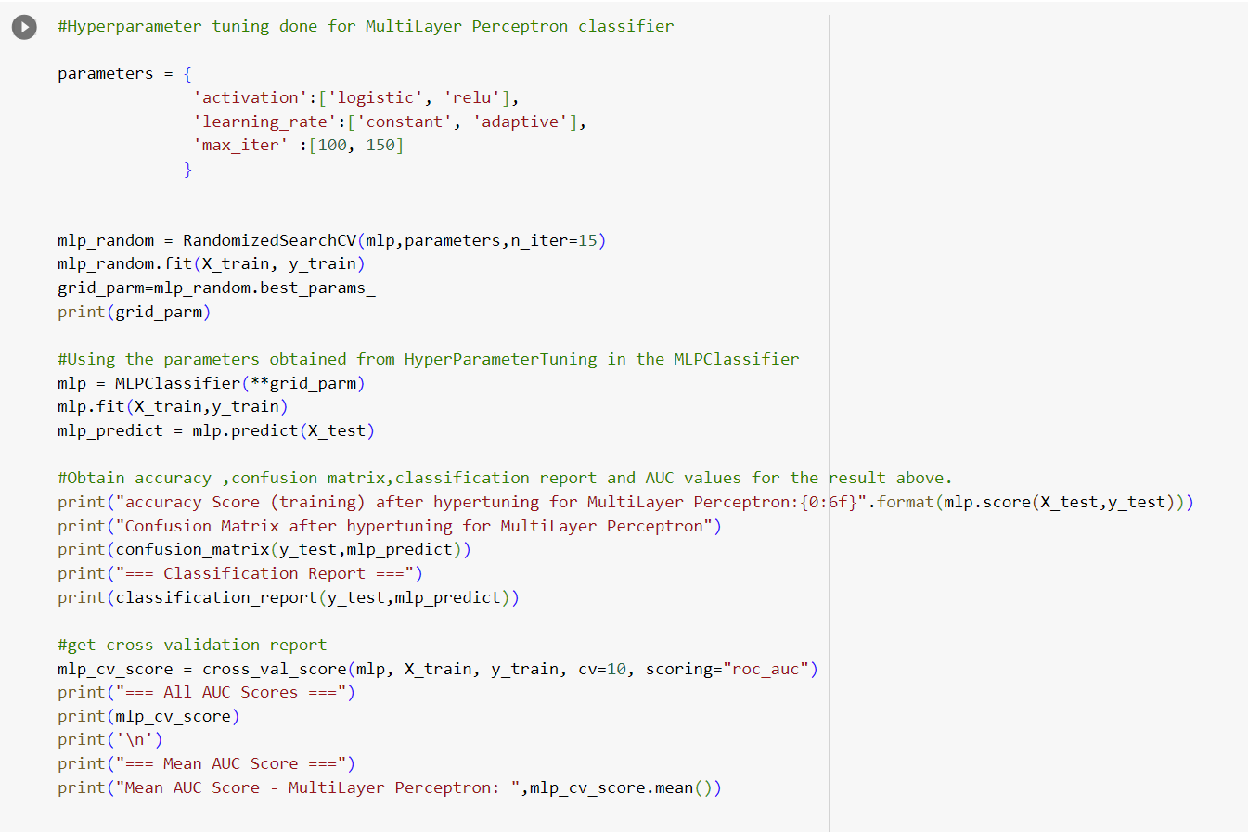
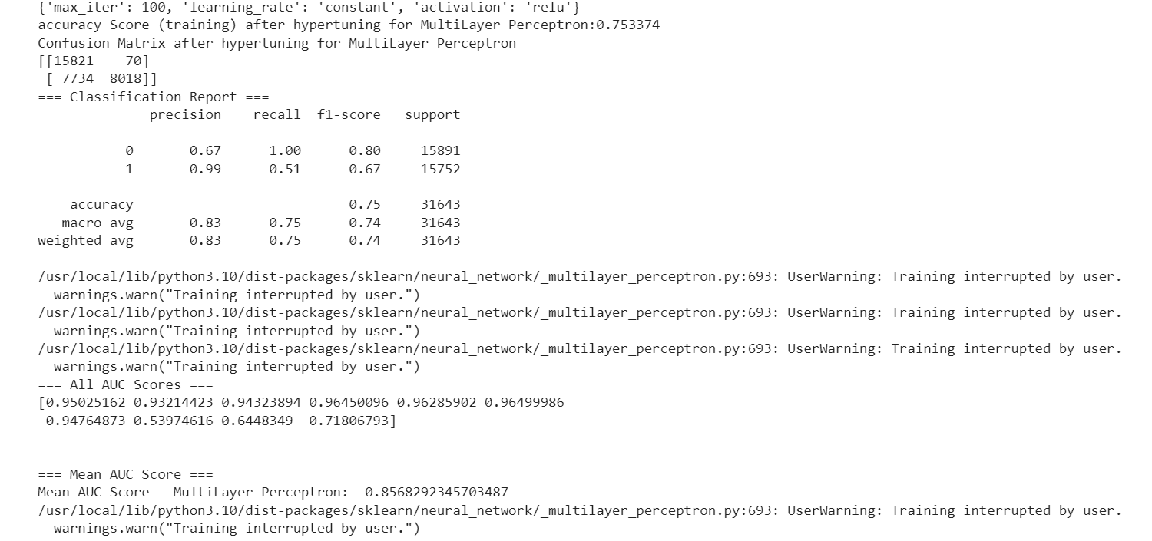
Checking performance of different models for meta model after stacking - MLP

Slide 12
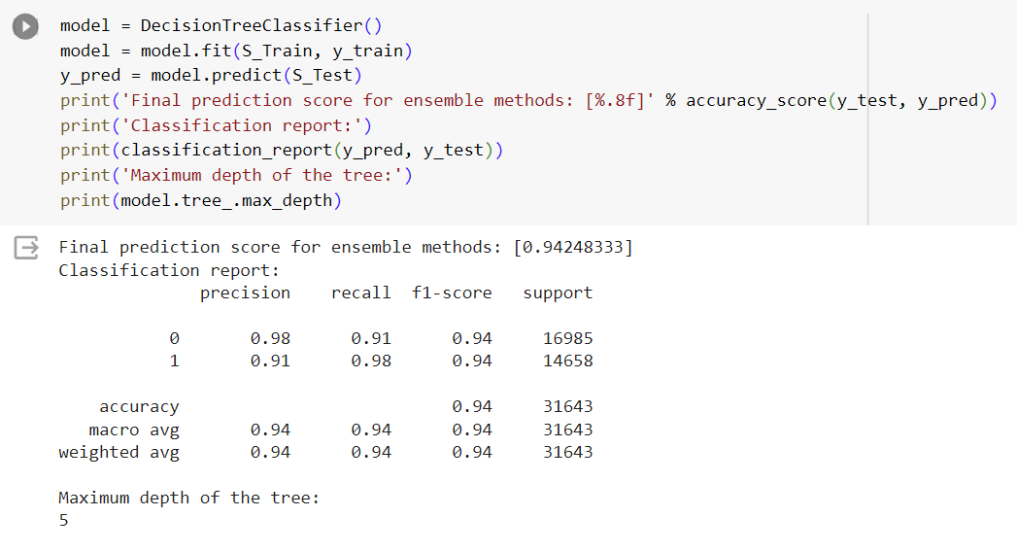
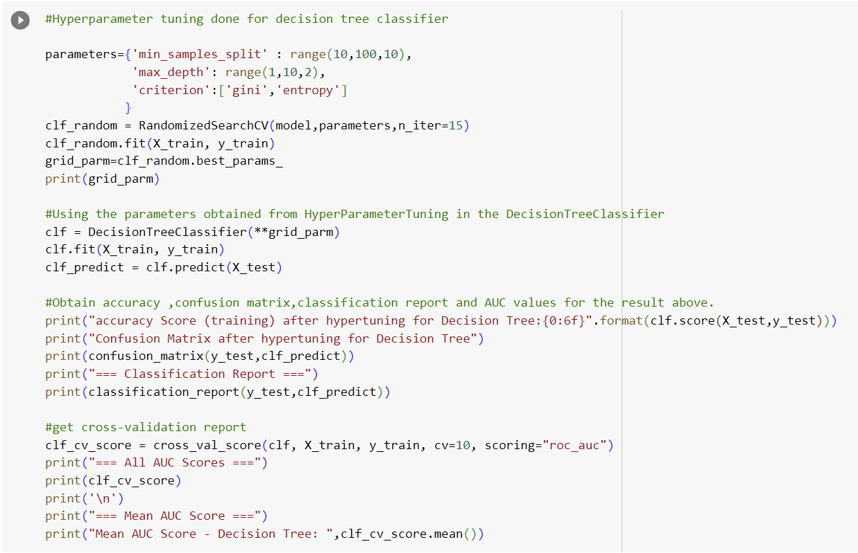
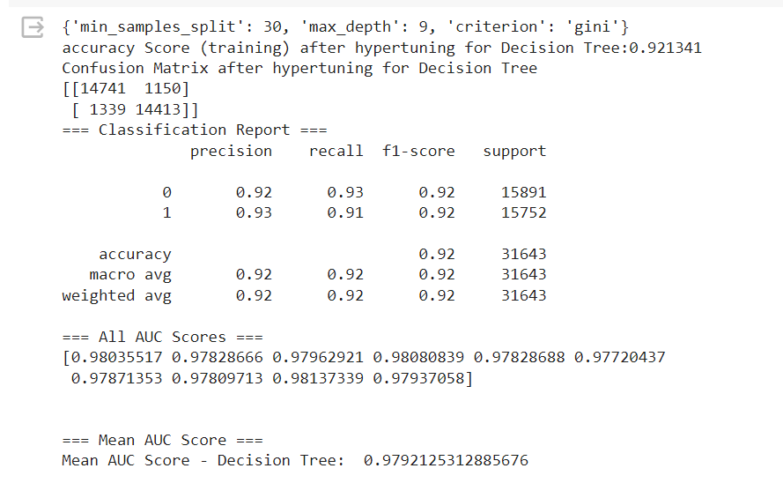
Checking performance of different models for meta model after stacking – Decision Tree

Slide 13
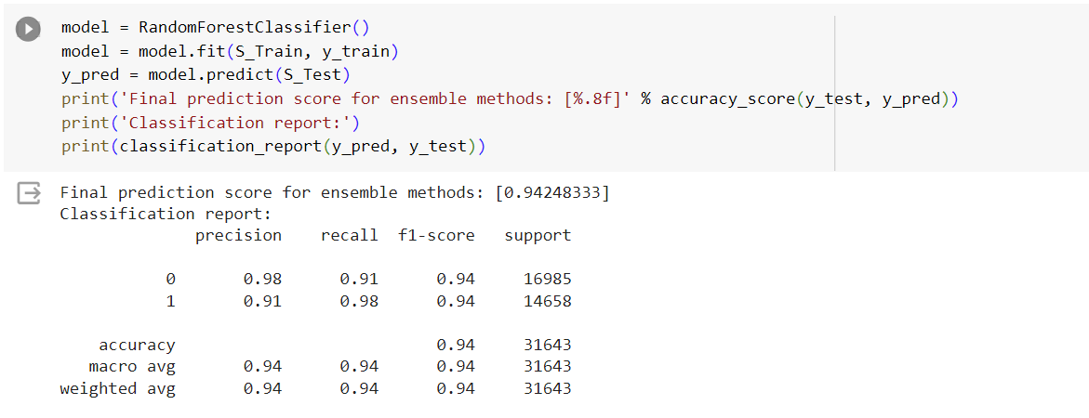
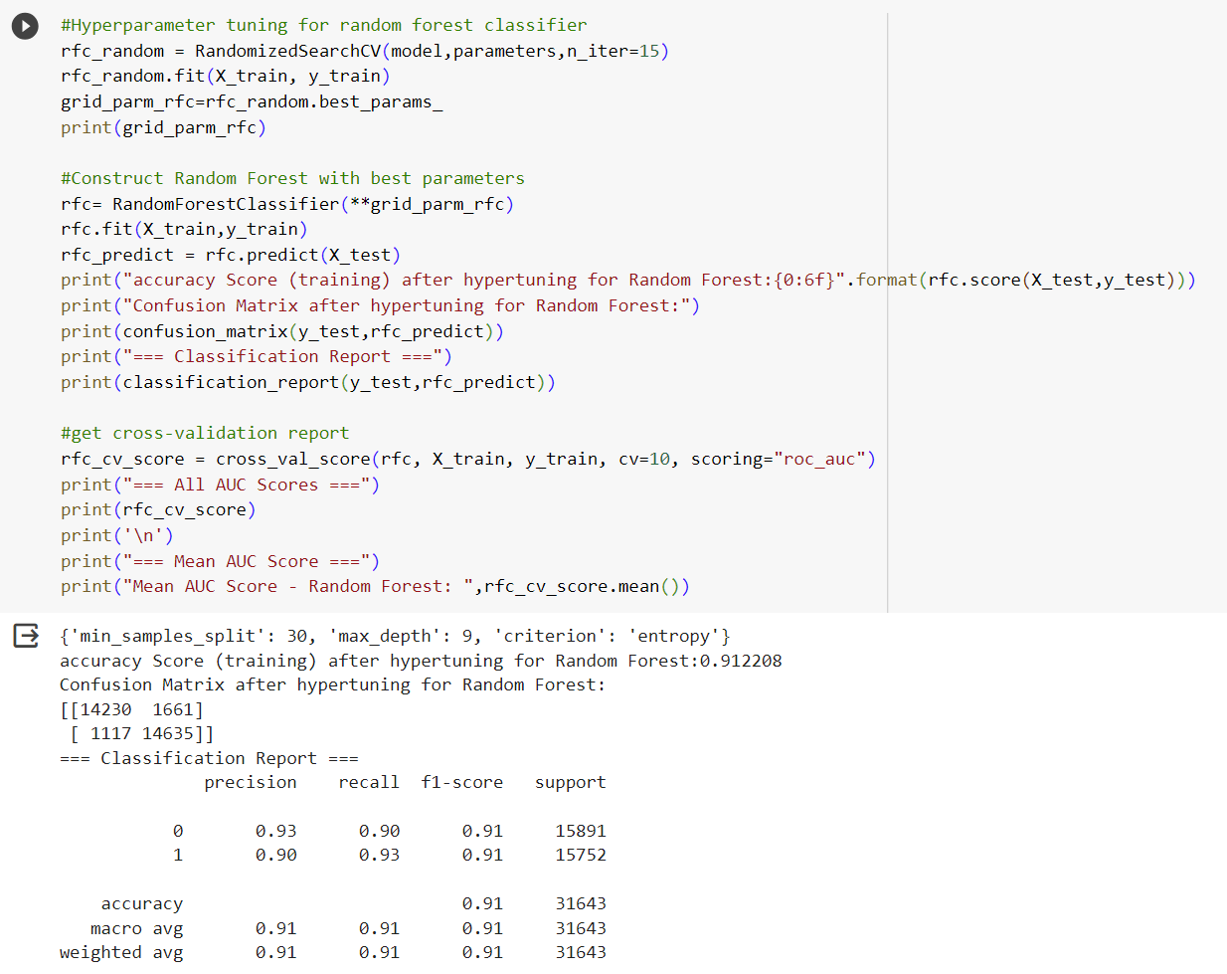
Checking performance of different models for meta model after stacking – Random Forest

Slide 14
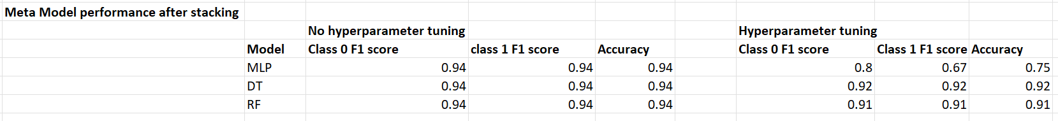
Comparing performances after stacking
Performance decreased after performing hyperparameter tuning.
Stacking provides a better performance when compared to individual models
For the final Kaggle scores, I will be training the individual models and the stacked models, without hyperparameter tuning.

Slide 15
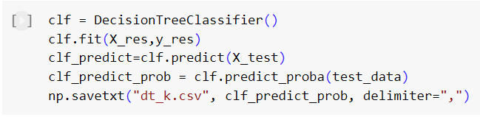
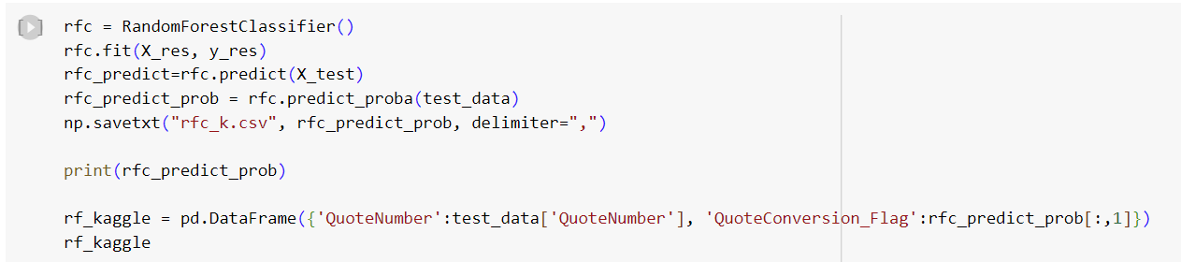

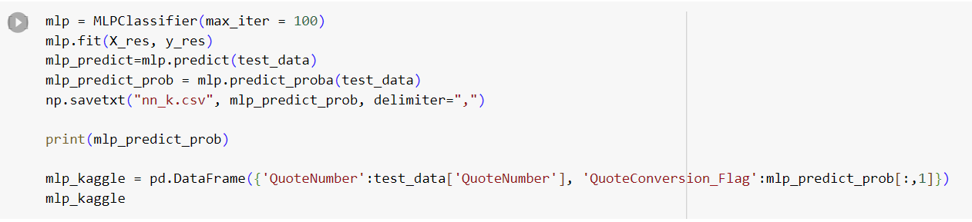
Individual Models

Slide 16
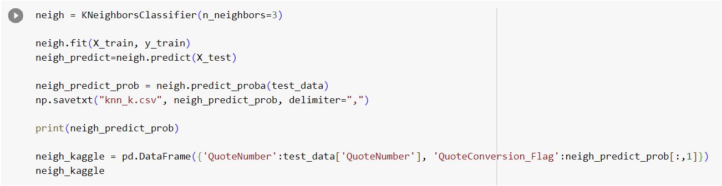
Individual Models

Slide 17
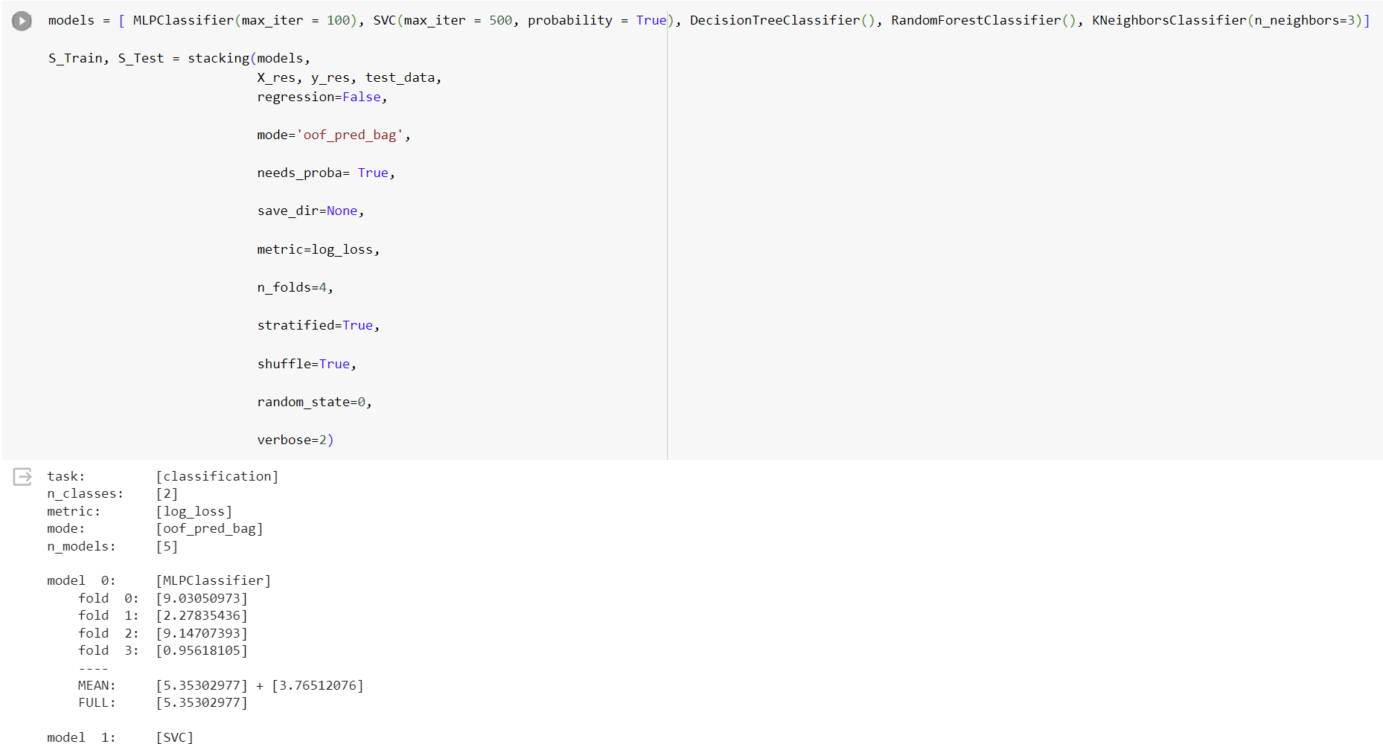
Stacking

Slide 18
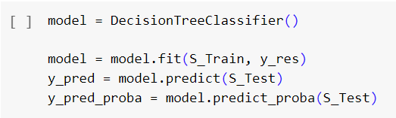
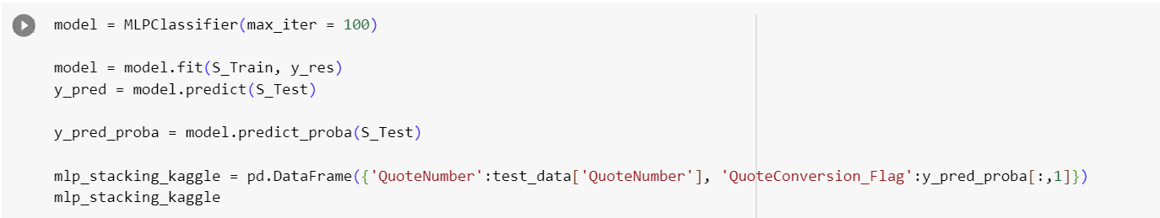
Creating meta models

Slide 19
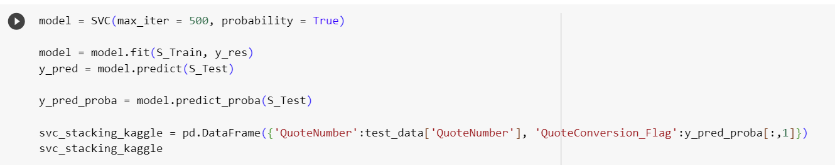
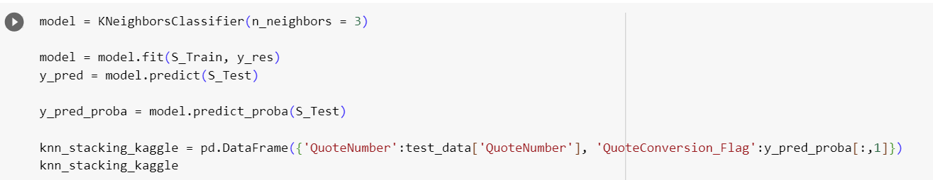
Creating meta models

Slide 20
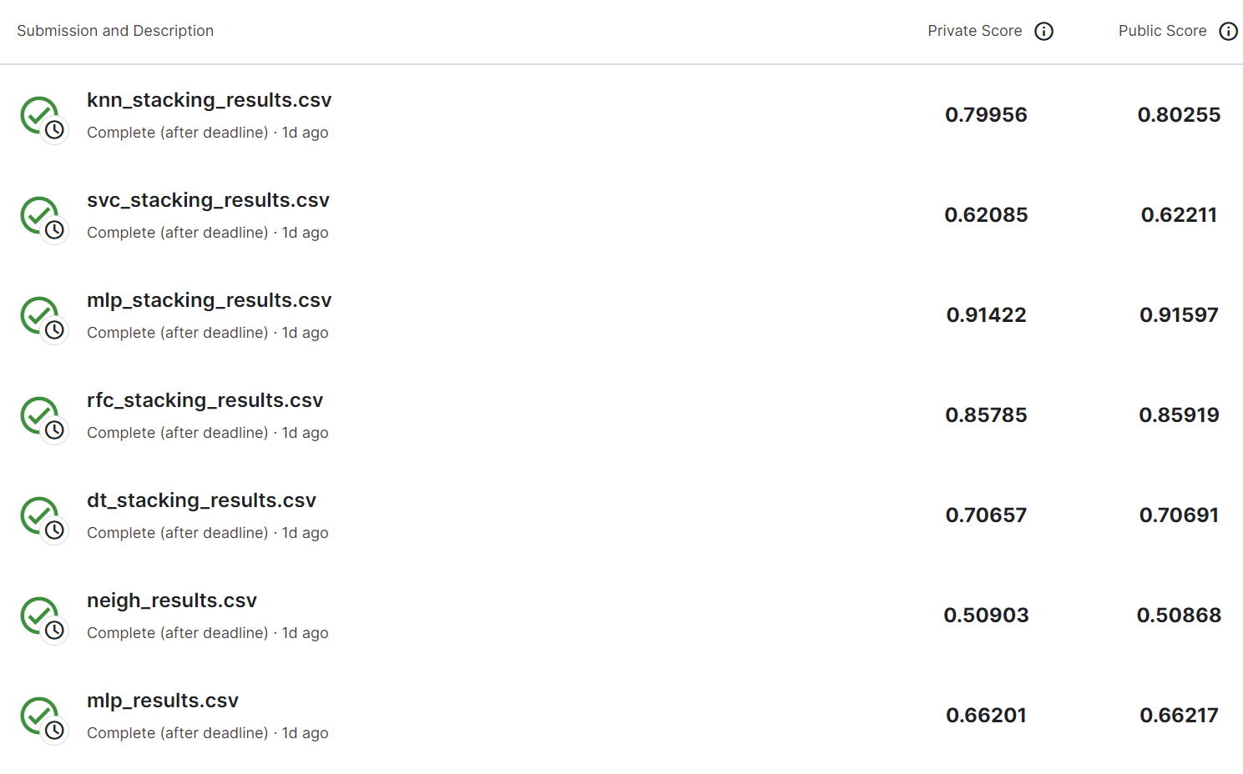
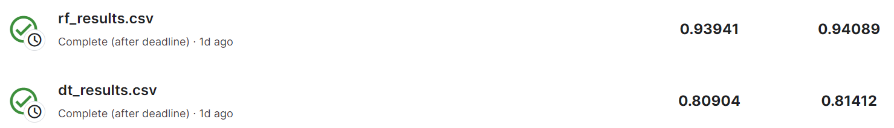
Kaggle scores

Slide 21
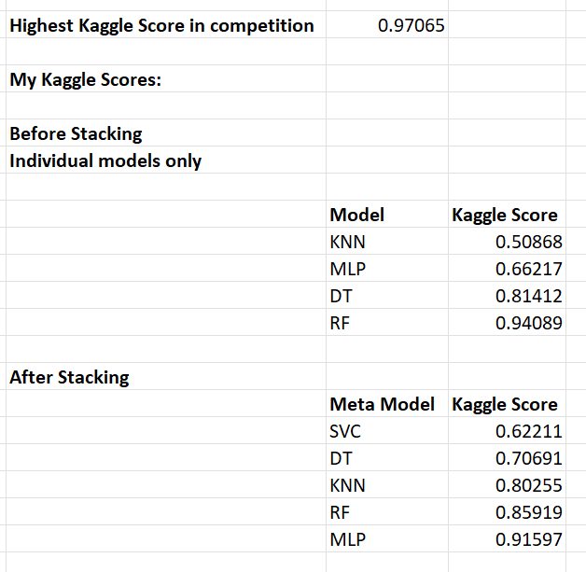
Comparing Kaggle scores
Stacking gave a lesser performance when compared to individual models
In individual models, Random Forest gave the best performance and KNN gave the worst performance
After stacking, MLP gave the best performance and SVC gave the worst performance.
The best Kaggle score was given by Individual Random Forest Model.

Slide 22
Conclusion
Stacking gave lesser performance when compared to individual models
Hyperparameter tuning gave lesser performance when compared to no hyperparameter tuning
Last assignment we worked with grid search as well, but this should not be used for this assignment because the dataset is already very large.
Last assignment, random forests were used: Multiple homogenous models (decision trees) are trained on different parts of the training dataset. This assignment we used stacking where multiple heterogenous models are trained on the same training dataset.

Slide 23
Thank You

